Slide 1
Engineering Project Management
Lecture 6:
Resource Analysis
and
Management
Engineering Management 6
1
Notes:
Dr Mahdi

Slide 2
Resource Analysis and Management
objectives in project management are achieved through the assignment of resources to areas of need. Consequently, resource management is essential to the achievement of successful operations.
Some resources, such as the people who are needed to do a job, possess special skills. Other resources, whether they be of personnel, materials, or tools, may be in very limited supply.
The relative importance of different resource types should be considered for resource management purposes.

Slide 3
RESOURCE ASSESSMENT
“Resource” refers to the manpower, tools, equipment, and other physical items that are available to achieve project goals.
Conceptual knowledge, intellectual property, and skill can all be classified as resources.
The lack or untimely availability of resources is a major impediment to manufacturing and automation efforts. Thus, resource management is affected by several constraints:
• Resource interdependencies
• Conflicting resource priorities
• Limitations on resource availability
• Limitations on resource substitutions
• Limitations on partial resource allocation

Slide 4
Resource Planning
Whether it is done for long-range (strategic) purposes or short-range (operational) purposes, planning should address the following components:
Project Goal and Objectives.
Technical and Managerial Approach.
Resource Availability.
Project Schedule.
Contingency Plan and Replanning.
Project Procedure.
Tracking, Reporting, and Auditing.

Slide 5
RESOURCE ALLOCATION IN PROJECT NETWORKS
CPM and PERT approaches both assume theoretically unlimited resource availability in project network analysis.
Now, both the time and resource requirements of activities are considered in the development of network schedules.
Projects are subject to three major constraints: time limitations, resource constraints, and performance requirements.
As these constraints are difficult to satisfy simultaneously, trade-offs must be made. The smaller the resource base, the longer the project schedule.
Quality of work may also be adversely affected by poor resource allocation strategies.

Slide 6
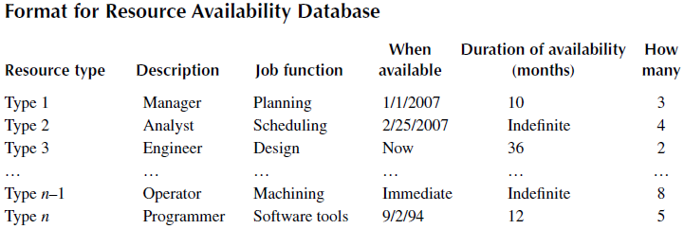
Resource Allocation …
Resource availability as well as other internal and external factors will determine how a project progresses from one state or stage to the next.

Slide 7
RESOURCE-CONSTRAINED SCHEDULING
A resource-constrained scheduling problem arises when the available resources are not enough to satisfy the requirements of activities that could be performed concurrently.
To satisfy this constraint, sequencing rules are used to determine which of the competing activities will have priority for resource allocation.
Instead of using mathematical formulations, a scheduling heuristic uses logical rules to prioritize and assign resources to competing activities.

Slide 8
Program Evaluation and Review Technique (PERT)
PERT and CPM have been used to plan, schedule, and control a wide variety of projects:
Construction of buildings and highways
Maintenance of large and complex equipment
Design and installation of new systems
A PERT network can be constructed to model the precedence of the activities.
The arcs of the network represent the precedence relationships of the activities.
The nodes (rectangles) of the network represent activities.
You will need to add a “Start” and a “Finish” nodes.
Activity time estimates usually can not be made with certainty.
PERT analysis is used when the duration of activities are not known with certainty. It involves three types of estimates of the duration of an activity instead of one single value as in the case of CPM:

Slide 9
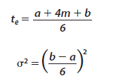
1. The optimistic duration a _ the time an activity will take under the most favourable conditions.
2. The pessimistic duration b _ the time an activity will take under the most unfavourable conditions.
3. The most likely duration m _ the most realistic time an activity will require to be completed, that is, the time an activity will take under normal conditions.
The duration of an activity is therefore assumed to have a beta probability distribution in PERT analysis. Following this distribution, the expected activity time, te, and the variance of the activity completion time, σ² can be obtained as follows:

Slide 10

Expected activity time, te , as obtained according to Equation 1 and by the variance of the activity completion time σ² as obtained according to Equation2 Therefore, the expected completion time of the project (µ_{p}) can be derived as well as the variability in the project completion time (σ _{p} ), as follows:

Slide 11
Example1:
The resource limitations are considered when creating the Gantt chart for the resource-constrained schedule. For this example, we will use the “longest-duration-first” heuristic to prioritize activities for resource allocation. Other possible heuristics are shortest-duration-first, critical-activities-first, maximum-predecessors-first, and so on.

Slide 12

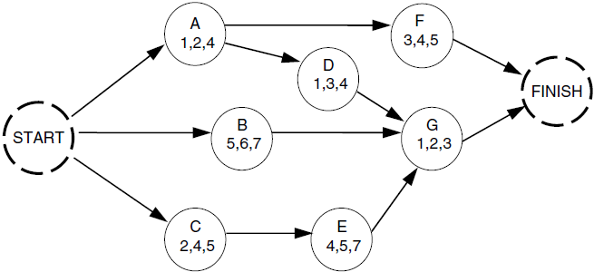
PERT uses three time estimates (a, m, b), and the following equation to compute expected duration:
:where
a = optimistic time estimate
m = most likely time estimate
b = pessimistic time estimate (a < m < b)
te = expected time for the activity

Slide 13
Example cont.:
Longest-Duration-First. The initial step is to rank the activities in decreasing order of their PERT durations, This yields the following priority order:
B, E, F, C, D, A, G
At each scheduling instant, only the eligible activities are considered for resource allocation. Eligible activities are those whose preceding activities have been completed.
A, B, and C can start at time zero as none of them have predecessors. These three activities require a total of 12 operators (3 + 5 + 4) altogether. But we have only 10.
So, we schedule B with 5 operators and C with 4 operators. The remaining 1 operator is not enough to meet the need of any of the remaining activities.

Slide 14
Example cont.:
We have one operator idle from time 0 until time 3.83, when activity C finishes and releases 4 operators. At time 3.83, we have 5 operators available. Since activity E can start after activity C, it has to compete with activity A for resources. According to the established priority, E has
priority over A.
So, 4 operators
are assigned
to E.

Slide 15
Examples 2
Riverwalk Associates is in the business of building elaborate parade floats. Its crew has a new float to build and want to use PERT to help them manage the project .
The table shows the activities that comprise the project. Each activity’s estimated completion time (in weeks) and immediate predecessors are listed as well.
The project manager wants to know the total time to complete the project, which activities are critical, and the earliest and latest start and finish dates for each activity.

Slide 16
Solution
Activity Expected Time and Variances
ti = (ai + 4mi + bi)/6 s2i = ((bi-ai)/6)2
Activity (i) Expected Time Variance (week2)
A 6 4/9
B 4 4/9
C 3 0
D 5 1/9
E 1 1/36
F 4 1/9
G 2 4/9
H 6 1/9
I 5 1
J 3 1/9
K 5 4/9

Slide 17
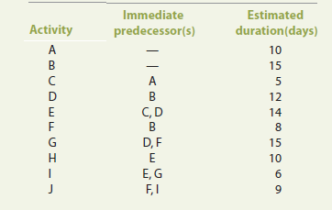
Examples 3
The next Table shows the information related to a project that involves the merger of two marketing firms (in days).

Slide 18
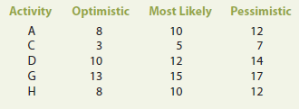
Draw the project network.
Develop the project schedule (EST, EFT, LST, LFT).
What are the critical activities?
What is the project completion duration?
If there is an option to delay one activity without delaying the entire merge project, which activity would you delay and why?
assume that the duration of some activities is not known with certainty. The estimates of these activities are shown below, assuming that the duration for the other activities remains unchanged.
What is the new critical path?
What is the project’s expected completion time and its variance?
Solution

Slide 19
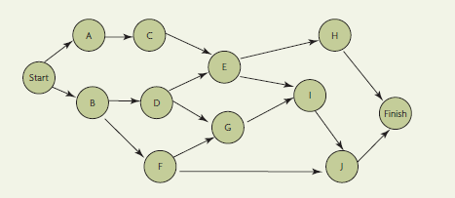
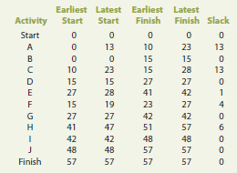
a. The project network is shown in this Figure
b. The project schedule is as follows:

Slide 20
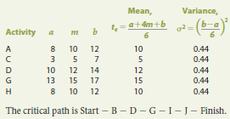
c. The critical activities are: B-D-G-I-J
d. The project completion duration is 57 days.
e. Activity A or C since they have the largest slack times.
f. When activities duration changed
The mean and variance for activities for which the duration is not known with certainty:
The expected project completion time is 57 days

